Slide 1
Dynamic Routing CS F303
Dr. Pranav M. Pawar

Slide 2
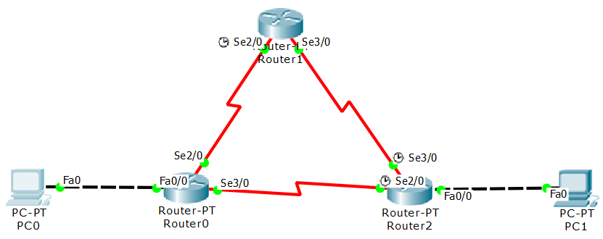
Network Topology

Slide 3
Assign IP Address PC
Assign IP address to PC0 and PC1
PC0
IP Address | 10.0.0.2
Subnet Mask | 255.0.0.0
Default Gateway | 10.0.0.1
PC1
IP Address | 20.0.0.2
Subnet Mask | 255.0.0.0
Default Gateway | 20.0.0.1

Slide 4
Configuring Router 0
Configure Fa 0/0, Se 2/0, and Se 3/0 interfaces
Router>enable
Router#configure terminal
Enter configuration commands, one per line. End with CNTL/Z.
Router(config)#interface FastEthernet0/0
Router(config-if)#ip address 10.0.0.1 255.0.0.0
Router(config-if)#no shutdown
Router(config-if)#exit
Router(config)#interface Serial2/0
Router(config-if)#ip address 192.168.0.252 255.255.255.0
Router(config-if)#no shutdown
Router(config-if)#exit
Router(config)#interface Serial3/0
Router(config-if)#ip address 193.167.0.219 255.255.255.0
Router(config-if)#no shutdown
Router(config-if)# exit
Router(config)#

Slide 5
Configuring Router 1
Configure Se 2/0 and Se 3/0
Router>enable
Router#configure terminal
Enter configuration commands, one per line. End with CNTL/Z.
Router(config)#interface Serial2/0
Router(config-if)#ip address 192.168.0.253 255.255.255.0
Router(config-if)#no shutdown
Router(config-if)#exit
Router(config)#interface Serial3/0
Router(config-if)#ip address 194.16.0.20 255.255.255.0
Router(config-if)#no shutdown
Router(config-if)# exit
Router(config)#

Slide 6
Configuring Router 2
Configure Fa 0/0, Se 2/0, and Se 3/0 interfaces
Router>enable
Router#configure terminal
Enter configuration commands, one per line. End with CNTL/Z.
Router(config)#interface FastEthernet0/0
Router(config-if)#ip address 20.0.0.1 255.0.0.0
Router(config-if)#no shutdown
Router(config-if)#exit
Router(config)#interface Serial2/0
Router(config-if)#ip address 193.167.0.218 255.255.255.0
Router(config-if)#no shutdown
Router(config-if)#exit
Router(config)#interface Serial3/0
Router(config-if)#ip address 194.16.0.21 255.255.255.0
Router(config-if)#no shutdown
Router(config-if)# exit
Router(config)#

Slide 7
Configure dynamic routing
For Router 0
Router>enable
Router#configure terminal
Enter configuration commands, one per line. End with CNTL/Z.
Router(config)#router rip
Router(config-router)#network 10.0.0.0
Router(config-router)#network 192.168.0.0
Router(config-router)#network 193.167.0.0

Slide 8
Configure dynamic routing
For Router 1
Router>enable
Router#configure terminal
Enter configuration commands, one per line. End with CNTL/Z.
Router(config)#router rip
Router(config-router)#network 192.168.0.0
Router(config-router)#network 194.16.0.0

Slide 9
Configure dynamic routing
For Router 2
Router>enable
Router#configure terminal
Enter configuration commands, one per line. End with CNTL/Z.
Router(config)#router rip
Router(config-router)#network 20.0.0.0
Router(config-router)#network 193.167.0.0
Router(config-router)#network 194.16.0.0

Slide 10
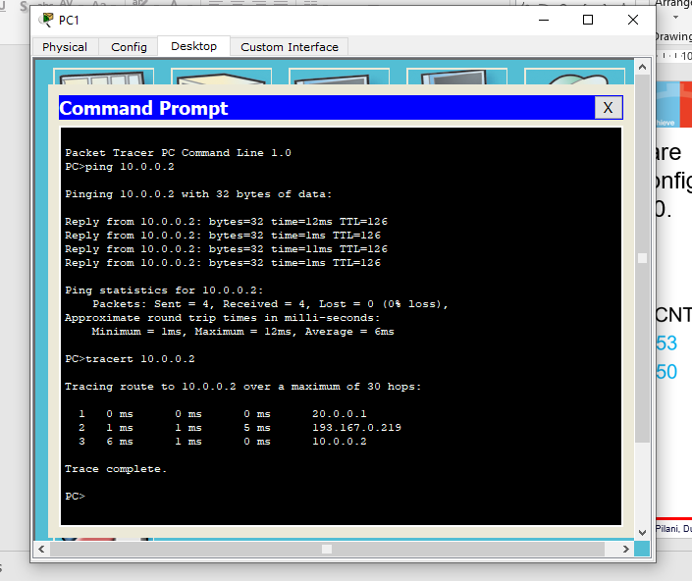
Testing of Scenario
Ping and tracert from PC1 to PC0 and vice versa

Slide 11
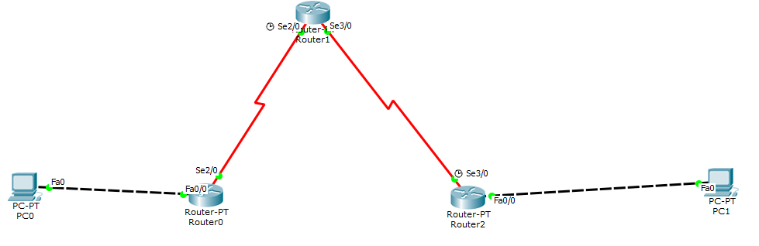
Remove Link Router 0-2
Remove link between Router 0 and Router 2.

Slide 12
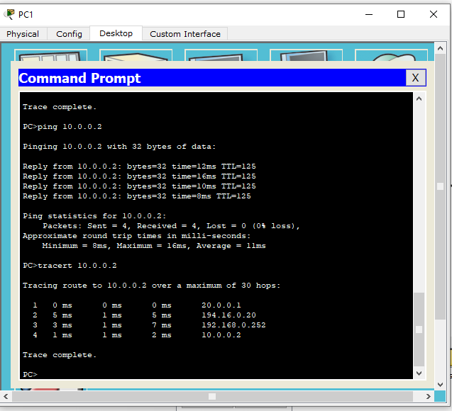
Testing of Scenario
Ping and tracert from PC1 to PC0 and vice versa.

Slide 13
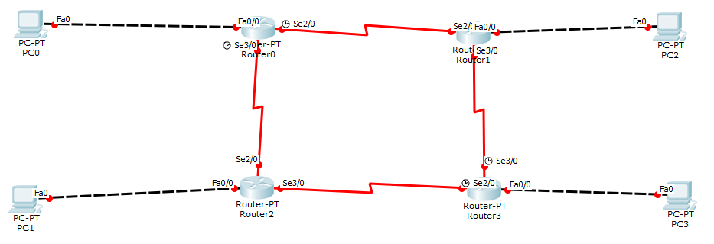
Practice Scenario
Simulate the dynamic routing by considering following network scenario.
Ping and tracert from PC0 to PC1,PC2,PC3 and vice versa.
Down the link between Router 0 to Router 2, and observe the difference between tracert outcome from PC0 to PC1.

Slide 14
Check routing table entries on each Router
Router>enable
Router#show ip route
Codes: C - connected, S - static, I - IGRP, R - RIP, M - mobile, B - BGP
D - EIGRP, EX - EIGRP external, O - OSPF, IA - OSPF inter area
N1 - OSPF NSSA external type 1, N2 - OSPF NSSA external type 2
E1 - OSPF external type 1, E2 - OSPF external type 2, E - EGP
i - IS-IS, L1 - IS-IS level-1, L2 - IS-IS level-2, ia - IS-IS inter area
* - candidate default, U - per-user static route, o - ODR
P - periodic downloaded static route
Gateway of last resort is not set
C 10.0.0.0/8 is directly connected, FastEthernet0/0
R 20.0.0.0/8 [120/1] via 193.167.0.218, 00:00:21, Serial3/0
C 192.168.0.0/24 is directly connected, Serial2/0
C 193.167.0.0/24 is directly connected, Serial3/0
R 194.16.0.0/24 [120/1] via 192.168.0.253, 00:00:02, Serial2/0
[120/1] via 193.167.0.218, 00:00:21, Serial3/0

Slide 15
Thank You!

